Slide 1

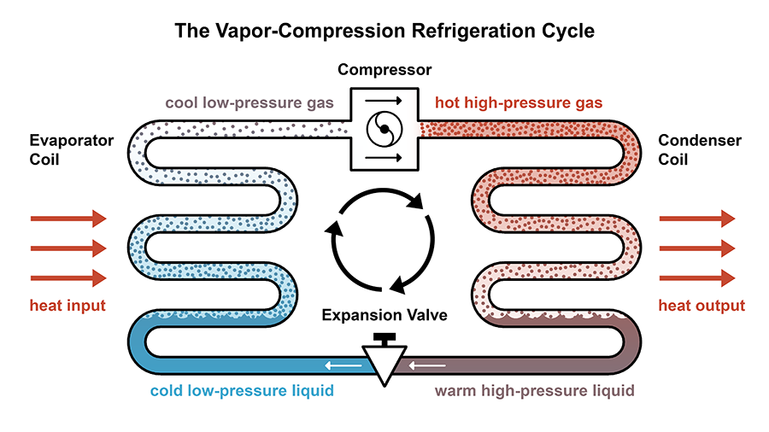
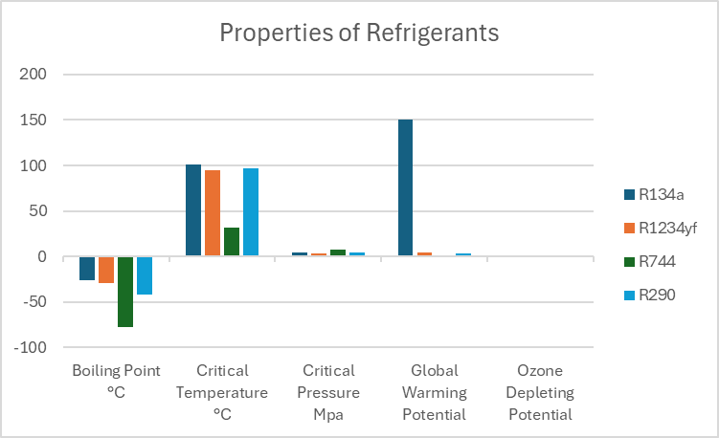
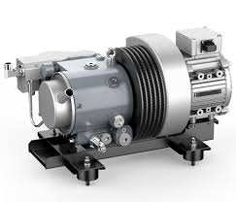
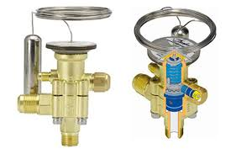
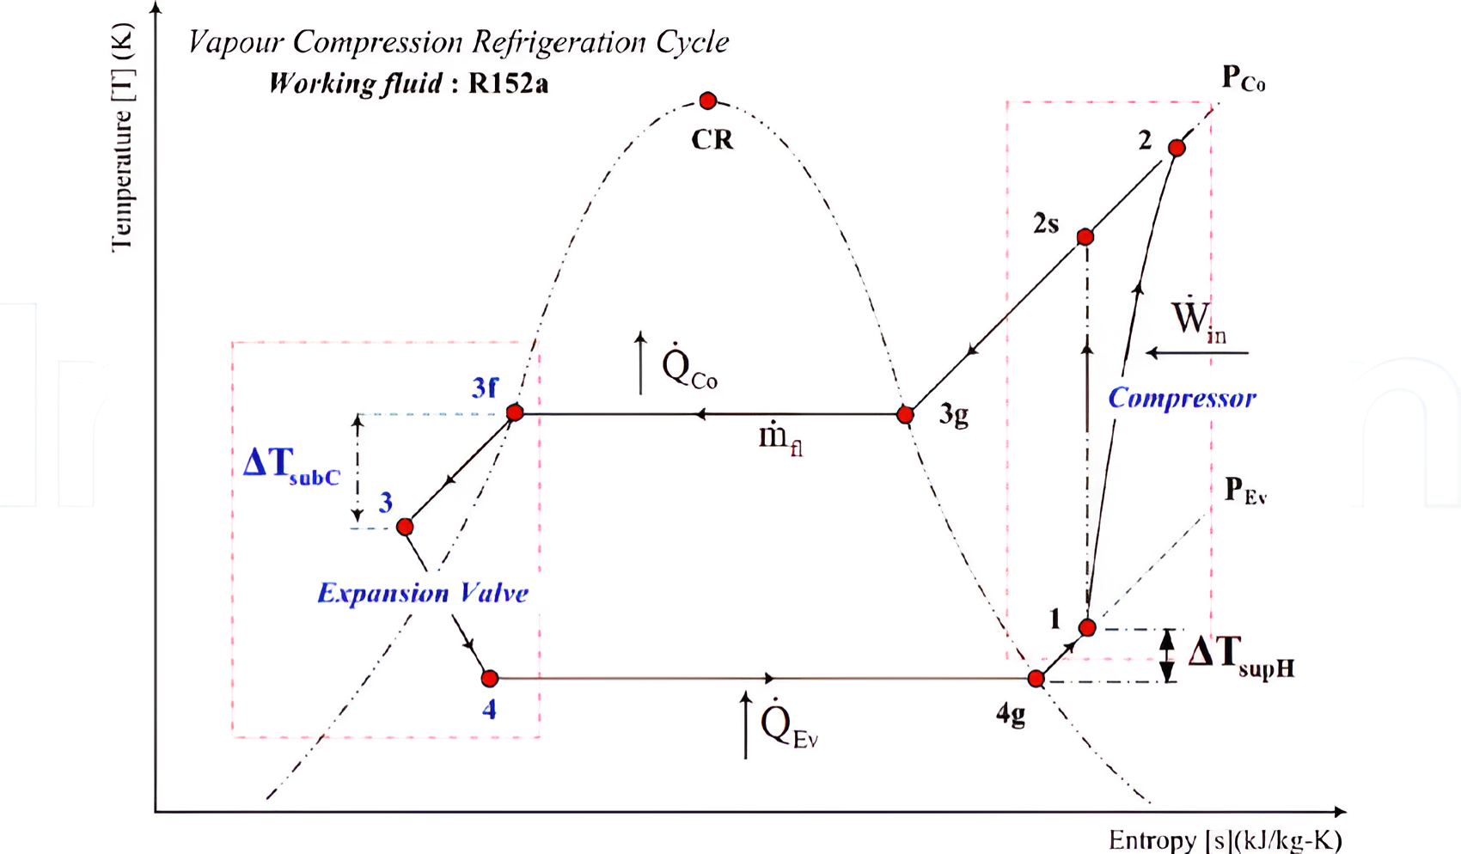

Study of Air Conditioning Unit Of Electrical Vehicles
Rounak Parsai (2022CH11445), Manish Meena (2022CH11035), Priyanshu (2022CH11465), Suyash Pankaj Gupta (2022CH11433)
Department of Chemical Engineering, Indian Institute of Technology, Delhi, 110016, New Delhi
The Vapor-Compression Refrigeration Cycle | daniel overbey // blog
Discussion
R134A, R1234YF, R410A and other refrigerants in common use have no destructive effect on the ozone layer, but their GWP values are relatively high.
The type of refrigerant used in the cycle affects efficiency and environmental impact. EV manufacturers are exploring low global warming potential (GWP) refrigerants to minimize environmental harm.
The electronic expansion valve is not only the main component to control the superheat of the system, but also the important component to regulate the air supply and flow of the system.
The performance of the R290 as a refrigerant is theoretically calculated in the report using the concepts of thermodynamics and heat transfer.
According to the principle of air enthalpy difference method, a laboratory for measuring the heat and cooling capacity of air conditioning systems is built.
Conclusions
The AC system plays a role in managing the battery temperature in addition to cooling the cabin. Proper battery thermal management is critical for battery longevity and performance.
Research into more efficient and environmentally friendly refrigerants can enhance the performance of AC systems while minimizing environmental impact.
Solar panels on the roof of an EV could power a ventilation system to keep the cabin cool while the vehicle is parked, reducing the need for intensive cooling when the vehicle is started.
R290 refrigerant has a lower molar mass than R134a, reducing flow requirements in heat pump systems and reducing costs compared to R134a, despite having lesser specific heat.
The air conditioning (AC) system can significantly increase the energy consumption of an EV, especially in hot climates. The system uses energy from the battery to function, which can reduce the vehicle's range.
There is still room for further research and development in areas such as thermoelectric cooling, energy harvesting, and high-efficiency components. These innovations could lead to more sustainable and efficient AC systems.
Methods and Materials
Results
The main components of air conditioning unit are compressor, condenser, expansion valve, evaporator and refrigerant.
The compressor creates the flow of refrigerant in the vapor compression cycle. The low temperature and low pressure refrigerant is compressed to high temperature and high pressure vapor which then forced to condenser from this compressor.
The condenser is a heat exchanger located at the front of the vehicle's cabin which condenses vapor to liquid at high pressure.
The high-pressure liquid refrigerant flows through the expansion valve, where it undergoes a sudden decrease in pressure. The cabin's evaporator enables the transfer of heat between the refrigerant and the warmer air inside the cabin.
The blower fan subsequently circulates the cooled air over the evaporator coils, resulting in a decrease in cabin temperature and a reduction in humidity levels due to the condensation of moisture on the surface of the evaporator.
The viable EV batteries used in AC systems are chemical batteries and ultracapacitors or supercapacitors.
Improving the insulation of the vehicle cabin can help maintain a stable temperature, reducing the load on the AC system and thereby conserving energy.
During the expansion step, the turboexpander can be used instead of a throttle valve to achieve higher efficiency. However, the turboexpander's large size makes it impractical for use in car air conditioning systems.
For cooling a wide range of temperatures and pressures we can use cascade compression cycles in which two separate cycles are used , this allows the high-temperature cycle to reject heat at a higher temperature level than it would achieve alone, increasing overall system efficiency.
Systems that recover waste heat from other vehicle components (such as the electric motor or power electronics) and use it to supplement the AC system can improve overall energy efficiency.
R290 ( C3H8 ) has its ODP is 0 and GWP is low which makes it suitable refrigerant.
Table 1. Comparison of thermophysical properties of refrigerants
 | R134a | R1234yf | R744 | R290
Chemical formula | CF3CH2F | CF3CF=CH2 | CO2 | C3H8
Boiling Point (◦C) | -26 | -29 | -78 | -42
Critical Temperature (◦C) | 101 | 94.7 | 31.4 | 96.7
Critical Pressure (MPa) | 4.1 | 3.4 | 7.4 | 4.2
GWP (Global Warming Potential) | 1300 | <4 | 1 | 3.3
ODP (Ozone Depleting Potential) | 0 | 0 | 0 | 0
Figure 1. Compressor
Figure 2. Thermostatic expansion valve
Figure 3. Vapor Compression Cycle
Figure 4. Spiral Compressor
Contact
References
Priyanshu, Entry: 2022CH11465, Mail: ch1221465@iitd.ac.in, Phone: 6395159299
Rounak Parsai, Entry: 2022CH11445, Mail: ch1221445@iitd.ac.in, Phone: 6267530325
Manish Meena, Entry: 2022CH11035, Mail: ch1221035@iitd.ac.in, Phone: 9680990691
Suyash Gupta, Entry:2022CH11433, Mail: ch1221433@iitd.ac.in, Phone: 7385946795
Huang, Y., Wu, X., & Jing, J. (2022, October 1). Research on the electric vehicle heat pump air conditioning system based on R290 refrigerant. Energy Reports. https://doi.org/10.1016/j.egyr.2022.05.112
https://www.researchgate.net/publication/274740746
Torregrosa-Jaime, B., Payá, J., & Corberan, J. (2013, April 8). Design of Efficient Air-Conditioning Systems for Electric Vehicles. SAE International Journal of Alternative Powertrains, 2(2), 291–303. https://doi.org/10.4271/2013-01-0864
Introduction to chemical engineering thermodynamics – J.M. Smith Davis, H. C. Van Ness ,M. M. Abbott, M. T. Swihart .
Heat transfer by J.P. Holman.

